Slide 1

English Skills Check
Level 6.1
Term 1 2021-2022
Federal Entity | هيئة اتحادية

Slide 2

Contents:
Part 1: Preparation - vocabulary
Part 2: Preparation - grammar
Part 3: Mini - research task
Part 4: Top tips
Level 6.1
Term 1 Academic Year 2021-2022

Slide 3

Part 1: Preparation – Vocabulary.
Learn these words for the skills check.

Slide 4



Tipi by open clip art vectors, , c.2020, from Pixabay.
shelter
a place that protects you from bad weather or danger
Autumn house icreated by banner vector, c.2020, freekpik.com

Slide 5
word | class | definition | sentence
shelter | noun | a place that protects you from bad weather or danger | Leila was very tired from climbing the mountain. She needed to find a shelter from the rain, wind and cold.

Slide 6

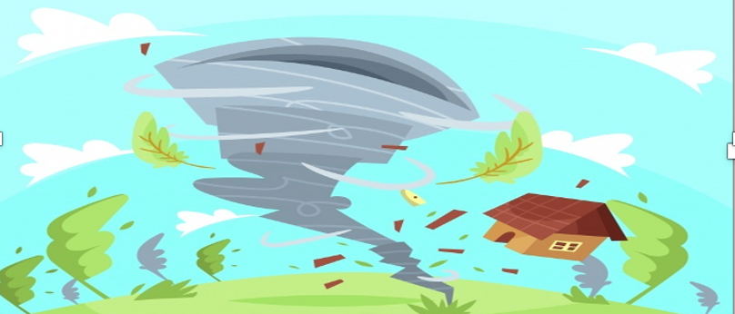
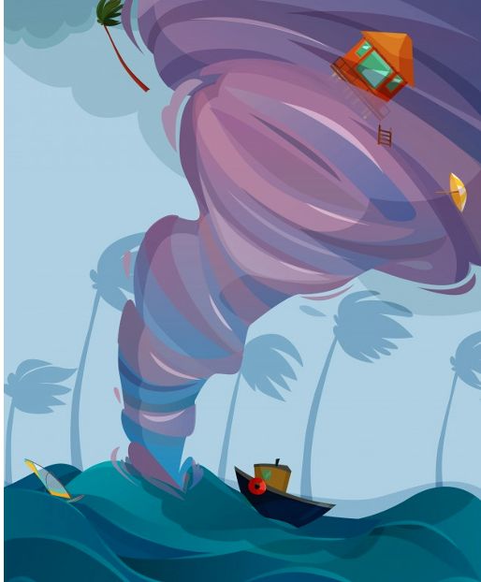
People vector Hurricane by nohat.cc. 2019 , from Freepic.com
hurricane
a heavy storm with very strong winds
Tornado Breakthrough Stormy Weather by Vincent HIE Cool Wall Decor Art Print, 2019,from Freepic.com

Slide 7
word | class | definition | sentence
hurricane | noun | a heavy storm with very strong winds | The wind was very loud – houses, cars and shops were destroyed in its path – it was a very strong hurricane!

Slide 8


Burn Red flare emergency created by Maria Leonza on Pinterest, 2017
(a) flare
a bright signal that is sent up when you are lost or injured
Burn red flare sos fire signal by Upklyak, 2018 created on Freepik.com

Slide 9
word | class | definition | sentence
(a) flare | noun | a bright signal that is sent up when you are lost or injured | They were lost in the mountains and used a flare to show the rescue team their location.

Slide 10
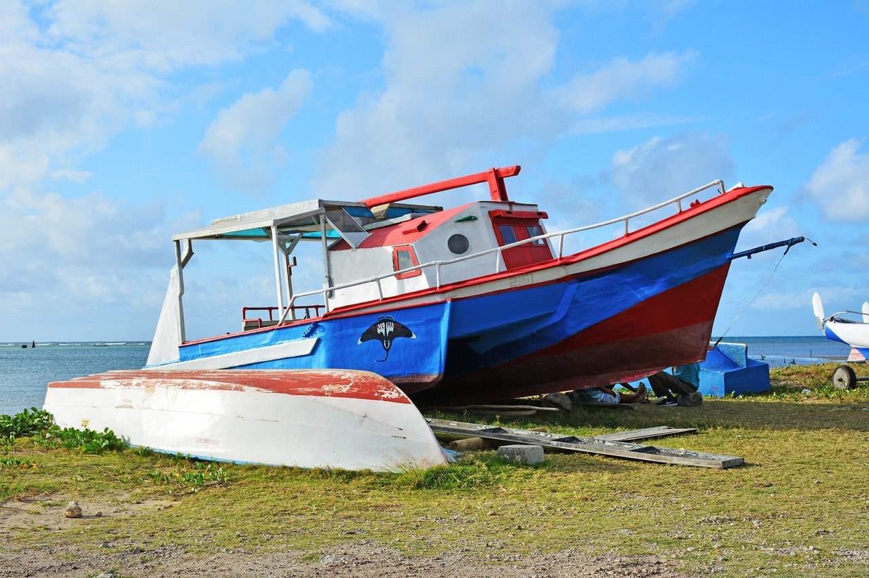
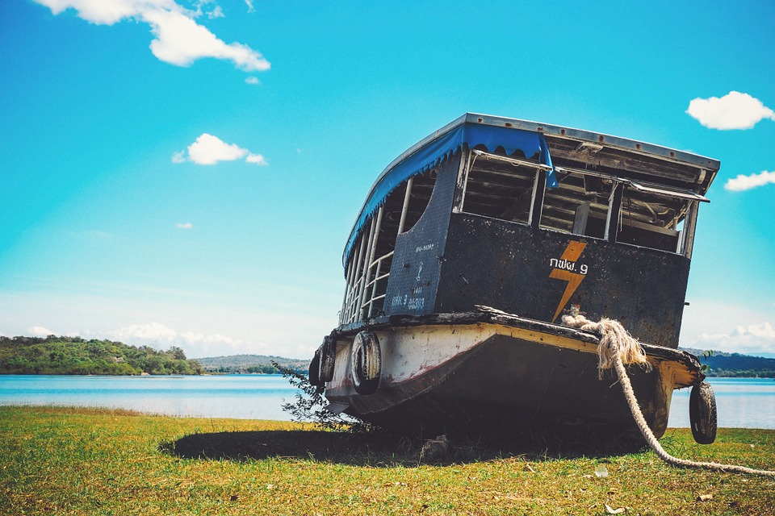
Fishing boat ashore by NikonD7100 c.2020, from Pixabay.com
ashore
to get off a boat that has stopped and move from water to land
Boat stranded ashore by cepublica, c.2015 from Pixabay.com

Slide 11
word | class | definition | sentence
ashore | adjective | to get off a boat that has stopped and move from water to land | He was seasick and so happy to leave the boat and go ashore onto calm, dry land.

Slide 12

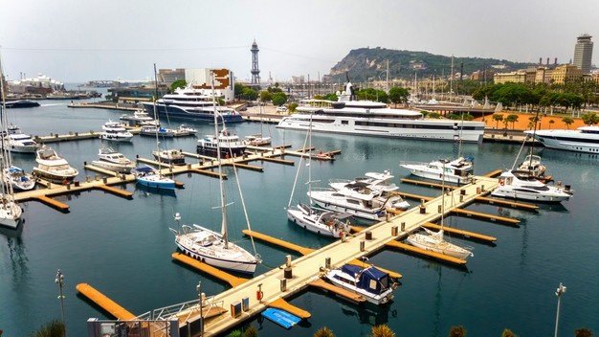
Cargo ship loading port -- People vector created by pch.vector, 2020, from Freepik.com
dock
to stop your boat at land then take goods off or pick new goods up
moored yachts sea port by Gusiness, c.2019, vector created by Freepik.com

Slide 13
word | class | definition | sentence
dock | verb | to stop your boat at land then take goods off or pick new goods up | They docked late at night and were happy to sleep before going ashore in the morning to get food and water.

Slide 14

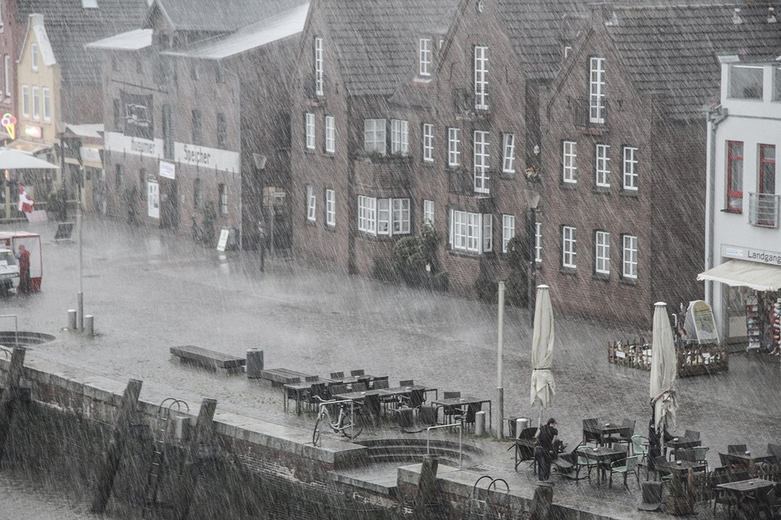
Frigate sailing stormy ocean - People vector by dreamtime, 2018, from Megapixel.com
the elements
the weather, especially bad weather
Rainy weather in port; by Wolfblur, c.2013, from Pixabay

Slide 15
word | class | definition | sentence
the elements | noun | the weather, especially bad weather | The walking tour was fun but the elements were bad as it snowed all day while they walked around the city.

Slide 16
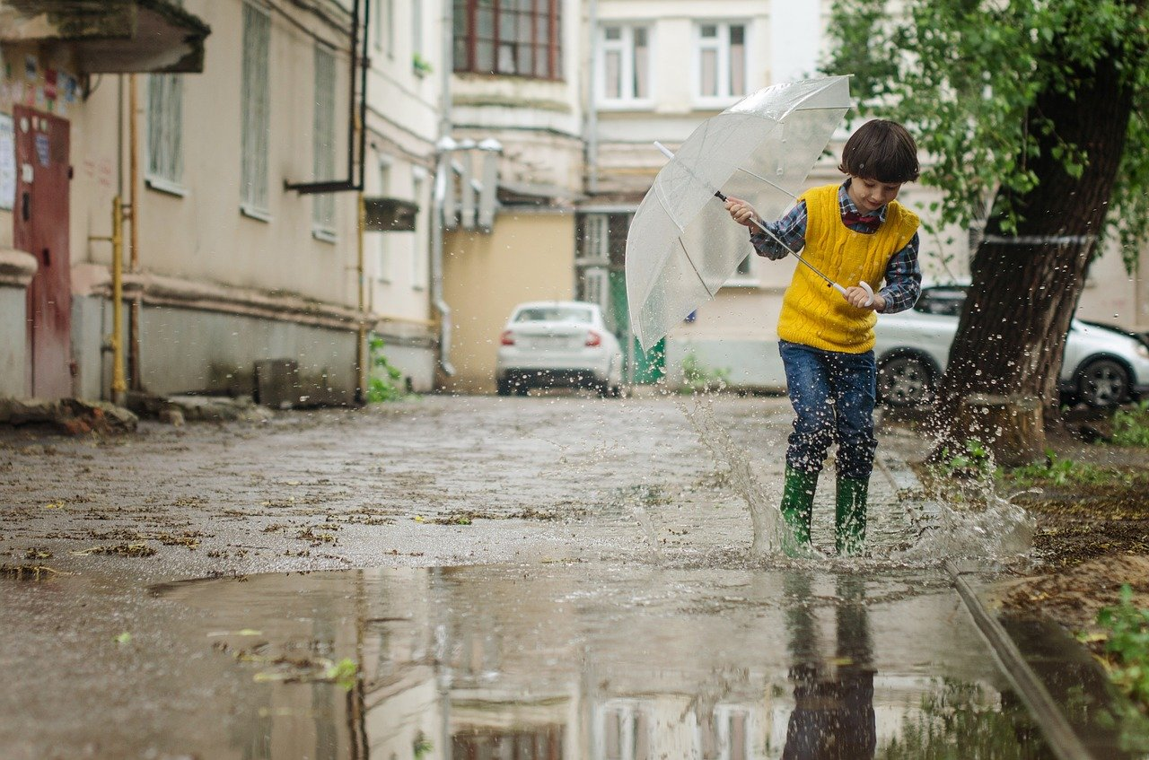
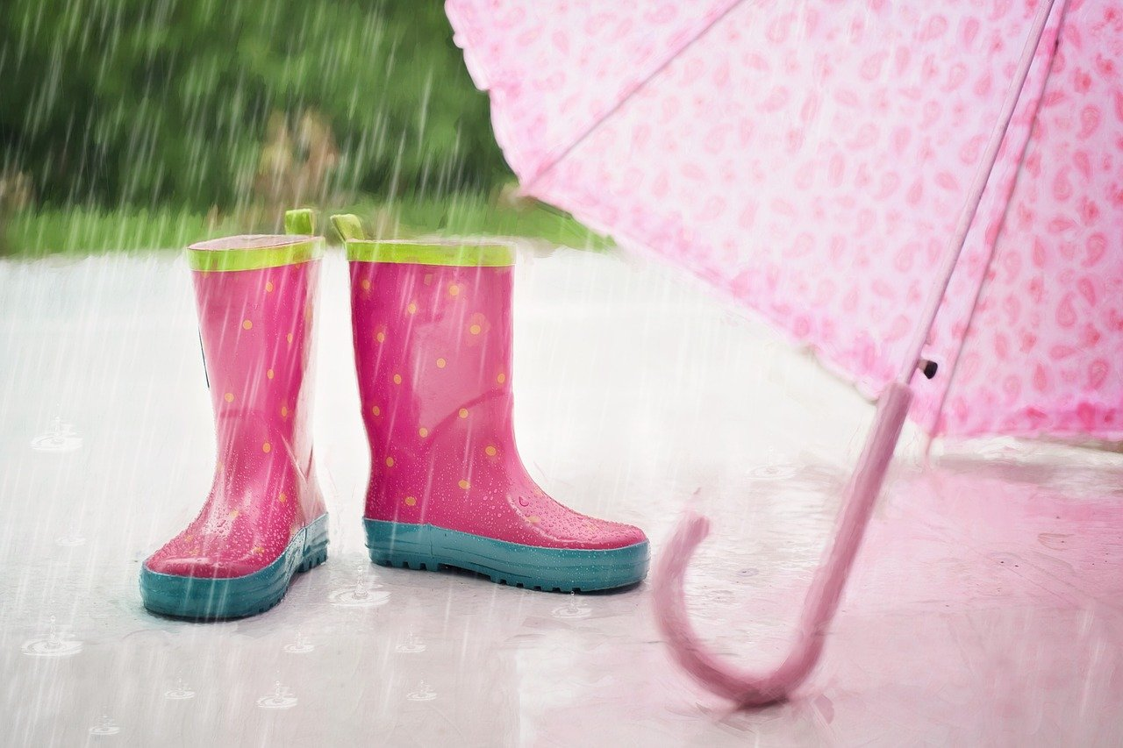
Umbrella, puddle, kid:Victoria Borodinova, 2017 from Pixabay
soaked (to the skin)
to be extremely wet
Rain; by Jill Wellington, c.2015, from Pixabay.com

Slide 17
word | class | definition | sentence
soaked | active verb | to be extremely wet | When he arrived home, he was very wet. The rain had soaked him to the skin.

Slide 18

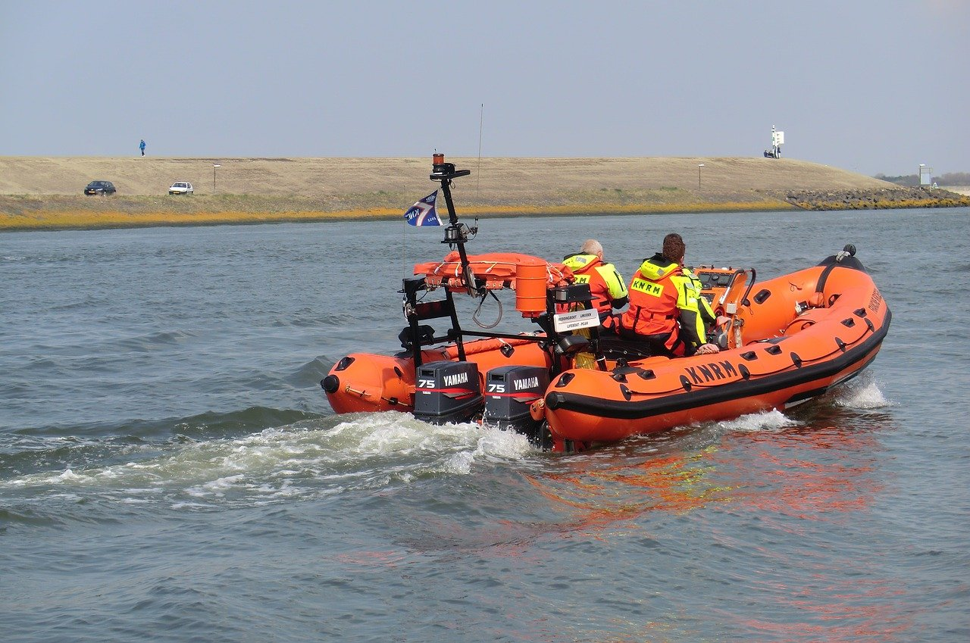
Man escaping from sinking ship in lifeboat by Redro.pl, 2021 from Freepik.com
lifeboat
extra boat on a ship or one that goes out to rescue people on a sinking ship
Coastguard by Elsemargriet, c.2018 from Pixabay.com

Slide 19
word | class | definition | sentence
lifeboat | compound noun | extra boat on a ship or one that goes out to rescue people on a sinking ship | The ship was sinking so they sent 2 large lifeboats to rescue all the people and get them off the ship.

Slide 20

Part 2: Preparation – Grammar
Review this grammar for the skills check.

Slide 21
You can get to work more easily by car – it’s faster than the bus.
Grammatical structure | Comparative adverbs -er on the end of it or more or less in front of it.
Usage | Comparing how we do something with something else
Meaning | The car is fast. You will get to work earlier if you go by car.
Other examples | It is less hard to study English than French It is less likely to rain than yesterday. We are more easily pleased by this film than that one.

Slide 22
I am friends with a girl who lives next door.
Grammatical structure | Defining relative clauses
Usage | They are introduced with relative pronouns 'that', 'which', 'who', 'whose', 'where' and 'when’. A defining relative clause tells which noun we are talking about. I like the woman who lives next door.
Meaning | The speaker says she has a friend. That friend is a girl and lives next door.
Other examples | He needs someone whom he can trust. I have a friend whose mum is a doctor. She's going to the museum which is full of interesting artefacts.

Slide 23
If she lived in Dubai, she would ride on the metro every day.
Grammatical structure | Second conditional If + past verb form + would/were + verb/adjective
Usage | The second conditional is used to talk about things which are unreal (not true or not possible) in the present or the future or things which don't or won't happen.
Meaning | The situation is not real. She does not live in Dubai. In the case that it was a real situation, and she lived in Dubai, then using the metro would be her transport.
Other examples | She would pass the exam if she studied. (She never studies, so this won't happen)

Slide 24
You can’t drive down that road. It’s closed.
Grammatical structure | Modals in the present Modal verb + infinitive verb (without to – unless exception – ie: have to)
Usage | Modal verbs, sometimes called modals, are auxiliary verbs (helping verbs). They express such things as possibility, probability, permission and obligation. Can, could, might, may, must, should, will, would, shall are modal verbs.
Meaning | You are not allowed to drive down that specific road.
Other examples | Obligation: You must / have to stop when the traffic lights are red. Advice: You should see a doctor. Prohibition: You mustn’t run near the swimming pool. Ability: I can run fast.

Slide 25
The chidren were driven to Dubai.
Grammatical Structure | Past simple passives 'was' or 'were’ + the past participle
Usage | The passive is used when the person or thing that did the action is unknown, unimportant or not the focus of our interest.
Meaning | We do not need to know who did the action – just that it ‘was done’ by someone else to the subject. It may have been their parents or another person who drove the children.
Other examples | A song was sung. The window was broken.

Slide 26
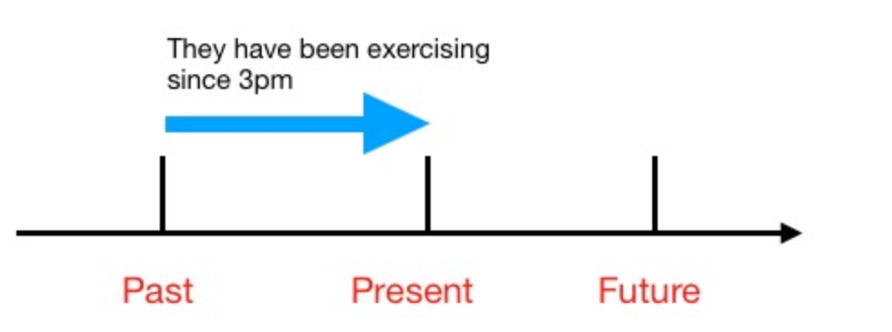
Present perfect continuous timeline by grammarwiz.com
I have been living in Dubai for 5 years now.
Grammatical Structure | Present perfect continuous have + to be + -ing verb form
Useage | The present perfect continuous usually shows duration, or the amount of time that an action has been taking place.
Meaning | In this case the sentence tells us of how long I have lived in Dubai and that I still live there now.
Other examples | I have been studying for three hours. I have been watching for a long time. They have been walking around the park all day.

Slide 27
I’ve closed the door so let’s start our lesson.
Grammatical Structure | Present perfect has / have + past participle verb form
Useage | The present perfect can be used to talk about something that has happened recently.
Meaning | In this case the speaker has recently closed the door. It sounds like the speaker might be a teacher.
Other examples | Have you eaten lunch? Where has he gone?

Slide 28
He jumped out of the way of the car.
Grammatical Structure | Non-separable phrasal verbs
Usage | Non-separable phrasal verbs cannot be broken up by other words.
Meaning | He moved quickly so he was not in front of the car anymore.
Other examples | He gets on with his mother-in-law well. I can no longer put up with this. Don't look down upon the poor.

Slide 29
He turned off the light / He turned the light off.
Grammatical Structure | Separable phrasal verbs
Usage | separable phrasal verbs can be broken up by other words
Meaning | Is the light on? No.
Other examples | I can put the picture up. / I can put up the picture. They called their friends over. / They called over their friends.

Slide 30

Part 3: Mini - research Task

Slide 31

Research it
Compare two local businesses.
Summarize the information in your own words.
Then talk about it with 1 or 2 classmates.

Slide 32

Talk about it
Talk about local businesses. Ask these questions to two of your classmates or family members. Record their answers.
 | Person 1 | Person 2
Which local business do you like using most ? What type is it? A shop? A cinema? A theme park?
What is a good business idea for local entertainment? What should the venue have in it?
Which business idea would you like to work on? Why?
Ask your own question.

Slide 33

Part 4: Top tips

Slide 34
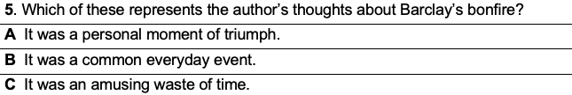
Top tips
The Skills Check is made up of three parts.
Part 1 – Reading passage
- 6 multiple choice questions
- Question 7 is reflection question which requires a written response. Justify your answer to the inference reading question by discussing other possible relevant answers, using evidence from the text or by explaining why you chose the answer that you did.

Slide 35
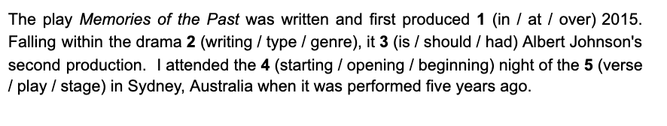
Top tips
Part 2 – MAZE
This assessment type is called a MAZE because it is a textual maze. Complete a short text by selecting the correct word or words. You may need to make connections between different parts of a text to be able to choose the correct answer.

Slide 36

Top tips
Part 3 - Writing
Short writing prompt
You will get marks for:
writing something about each of the bullet points
using paragraphs that are structured the way your teacher has taught you
using vocabulary that is appropriate for the topic
writing with simple and complex sentences
showing consistent control and overall accuracy of grammar structures
showing accuracy in spelling and punctuation

Slide 37



Follow us
ese.ae
Ese_ae

